Slide 1
MICROBIAL GENETICS2

Slide 2
Basic Concepts
Mutations
Gene Transfer in Bacteria

Slide 3
Basic Concepts
Nucleic Acids
Composed of chains of nucleotides
Nucleic acid molecules are usually composed of
4 different nucleotides
A nucleic acid molecule may contain several thousands or millions of nucleotides
Each nucleic acid molecule has its own order, or “sequence,” of nucleotides
The correct sequence of nucleotides is essential for the nucleic acid’s function

Slide 4
Nucleotide structure
A nucleotide consists of:
Nitrogenous base
Pentose sugar
Phosphate group
Nitrogenous bases:
Purines: adenine & guanine
Pyrimidines: cytosine, thymine (in DNA), & uracil (in RNA)
Pentose sugars:
Ribose (found in RNA)
Deoxyribose (found in DNA)

Slide 5
DNA: Deoxyribonucleic acid
Pentose sugar: 2’-deoxyribose
Nitrogenous bases: Adenine and guanine (purines) Cytosine and thymine (pyrimidines)
Structure is typically a double-stranded helix
Nucleotide sequences of the strands are complementary to each other, A pairing with T and C pairing with G

Slide 7
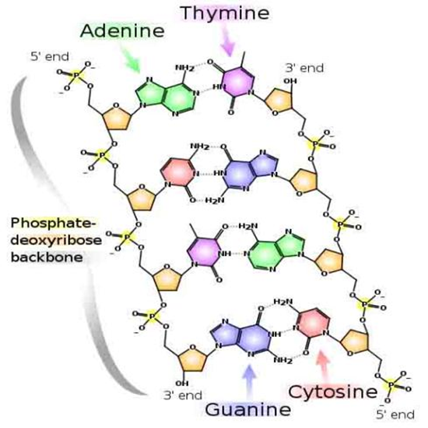

Slide 8
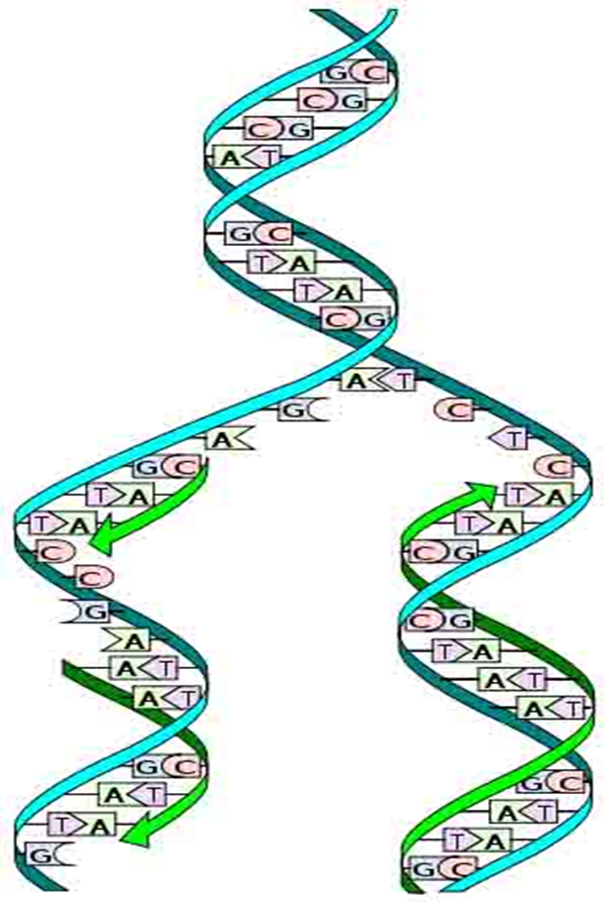

Slide 9
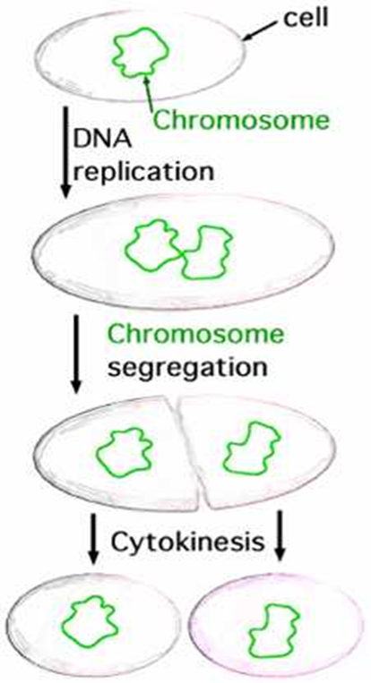
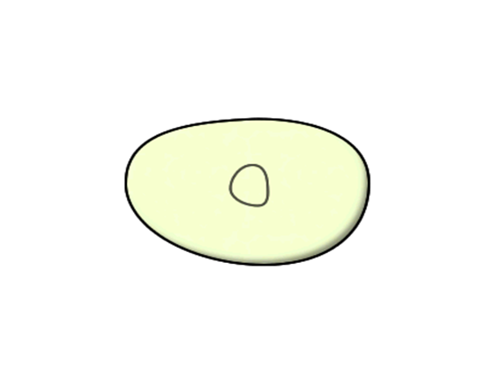

Slide 10
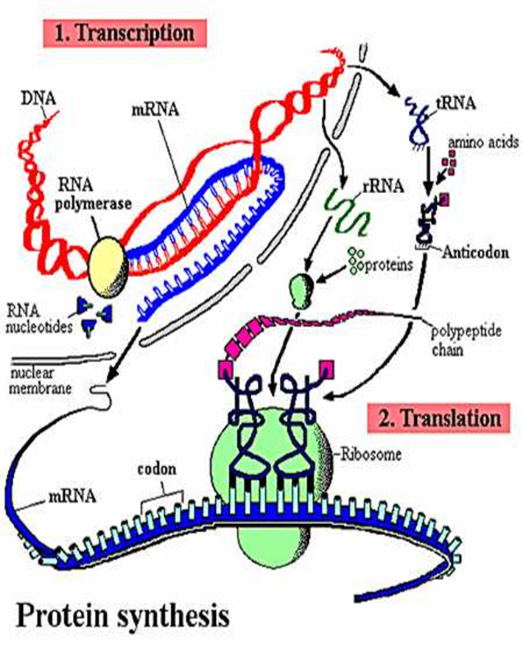

Slide 11
RNA: Ribonucleic acid
Pentose sugar: Ribose
Nitrogenous bases: Adenine and guanine (purines) Cytosine and uracil (pyrimidines)
Structure is typically single-stranded; there may be internal complementary regions within an RNA strand that can form double-stranded “hairpin loops” (C to G; A to U)
An RNA strand can also form a double-stranded structure with a DNA strand; in this case, the U on the RNA will base-pair with the A on the DNA.

Slide 12
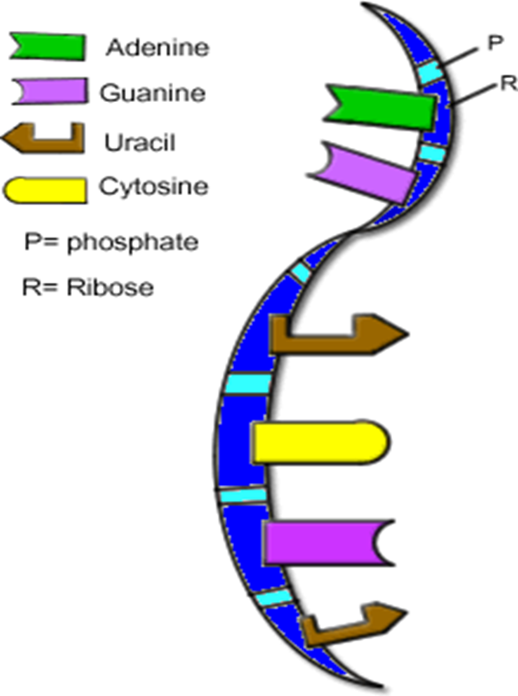
Nucleic Acids: RNA Structure

Slide 13
Overall function.
The nucleotide sequence of a nucleic acid molecule encodes the amino acid sequence of a protein.
Genome: The entire nucleotide sequence of an organism; transmitted to offspring during reproduction
Deoxyribonucleic acid (DNA): DNA molecules serve as the genome for the proteins of all cellular organisms, both eukaryotic and prokaryotic. DNA also serves as the genome for certain viral groups.
Ribonucleic acid (RNA): RNA molecules serve as an intermediate in gene expression in eukaryotic and prokaryotic organisms, as well as some viruses. RNA serves as the genome for certain viral groups.

Slide 14
Important Processes in Genetics
DNA Replication: The sequence of a nucleotides in a DNA molecule serves as a template to copy itself, so two identical copies of the DNA helix are formed.
Transcription: The sequence of nucleotides in a DNA molecule serves as a template for the synthesis of an RNA molecule; typically, only a small segment of the DNA is copied. This is the first step in gene expression.
Translation: The sequence of nucleotides in an RNA molecule serves to direct the assembly of amino acids into a protein chain on a ribosome. This is the second step in gene expression.

Slide 16
Gene
Contemporary understanding:
A segment on a DNA molecule
Usually at a specific location (locus) on a chromosome or plasmid
Characterized by its nucleotide sequence
Genes play three notable roles:
To encode the nucleotide sequences of mRNA, which in turn encodes the amino acid sequences of proteins
To encode the nucleotide sequences of tRNA or rRNA
To regulate the expression of other genes
Mutation:
Change in the nucleotide sequence of a gene, usually resulting from an error during DNA replication

Slide 17
Phenotype
The appearance or discernible characteristics of a trait in an individual
Mutation in a gene responsible for a phenotype may cause a change in the phenotype.
Typically, more than one gene is responsible for a phenotype.
Genotype
The genetic makeup of an individual with reference to one or more specific genes
A genotype is designated by using symbols to represent the mutations of the gene

Slide 18
Microbial Genotypes & Phenotypes
Microbial phenotypes are usually designated by a non-italicized 3-letter abbreviation that in some way refers to the appearance or effect of the phenotype. Variation in the phenotype may be designated by superscripts such as “+” or “–” for auxotrophic mutations, “R” or “S” for antibiotic resistance mutations, etc.
Microbial genes are usually designated by an italicized, 3-letter abbreviation (that often refers to the phenotypic effect by which the gene was discovered) plus a letter that distinguishes one gene in a family from other genes that produce the same phenotype.

Slide 19
For example:
A lysine prototroph of E. coli, capable of making its own lysine, is designated lys+. An auxotrophic mutant, incapable of making its own lysine, is designated lys–.
There are several different genes responsible for lysine production in E. coli. These genes encode the different enzymes in the metabolic pathway for lysine synthesis. The genes are designated lysA, lysB, lysC, and so on.
Mutation in any of the genes responsible for lysine production may block the lysine pathway and produce the Lys– phenotype.

Slide 20
Mutations
Mutations : Definitions
Lethal mutation: results in death of the cell, and therefore cannot be propagated or studied
Conditional mutation: One that is expressed only under certain environmental conditions; for example, a temperature-sensitive mutation
Biochemical mutations: result in change in a biochemical pathway of the cell; for example, an auxotrophic mutation
Spontaneous mutation: one that arises spontaneously due to error during DNA replication
Induced mutation: one that has been caused by damage resulting from chemical or radiation treatment (mutagen)

Slide 21
Mechanisms of Induced Mutation
Base analogs
A chemical similar in structure to one of the bases and can substitute for it but doesn’t base pair normally
For example, 5-bromouracil substitutes for thymine, but it frequently pairs with a G instead of A
Specific Miss-pairing
When a mutagen changes a base’s structure and thereby alters its base pairing
For example: nitroso-guanidine adds a methyl group to guanine, causing it to pair with T instead of C.

Slide 22
Intercalating agents
Examples include acridin orange and ethidium bromide
Flat, planar, aromatic molecules that can fit between the stacked bases (intercalate) in the center of a DNA double helix and distort its geometry
The distortion somehow induces single nucleotide insertions or deletions

Slide 23
Bypass of replication
Chemical change or damage to bases is so severe that the bases can no longer base pair at all, and cannot serve as a template
Example: formation of thymine dimers by UV irradiation; these cannot hydrogen bond at all
Normally this would be lethal, but there are repair mechanisms that can bypass the damaged template, although many of these repair mechanisms are error-prone so generate a high frequency of mutations

Slide 24
Gene Transfer in Bacteria
Conjugation
A process of gene transfer from a living donor cell to a living recipient cell
Typically, the donor cell will possess conjugative structures on its surface that attach the donor cell to the recipient cell. The conjugative structures will also mediate the transfer of DNA from the donor to the recipient.
The ability to conjugate is often encoded on a plasmid.
For example: In Escherichia coli, conjugation is mediated by the F pili that are encoded for by genes on the F plasmid.

Slide 26
Conjugation (cont.)
A strain of E. coli having F plasmids and pili is called an F+ strain; a strain lacking F plasmids or pili is F–.
When an F+ cell (the donor) is mated with an F– cell (the recipient), a copy the F plasmid is transferred to the F– cell, so that after the process is complete, both cells will be F+.
In a cross of F+ x F–, only the plasmid is transferred. None of the chromosomal genes are transferred. Therefore, an F+ x F– does not give us any information about the position of genes on the bacterial chromosome.

Slide 27
Conjugation (cont.)
In some strains of E. coli, an F plasmid DNA sequence has become inserted into the chromosome through genetic recombination. These are called Hfr strains. Different Hfr strains have the F sequence inserted at different locations on the chromosome.
The cells of Hfr strains have F pili, and are capable of conjugating with F– cells. In an Hfr x F– mating, the F sequence is transferred first, followed by the chromosomal DNA.
Genes from the Hfr (donor) chromosome can replace genes in the F– chromosome by genetic recombination.

Slide 29
Gene Transfer in Bacteria
Transduction
Transfer of genes from a donor cell to a recipient cell through a bacteriophage intermediate.
Bacteriophage: A bacterial virus
Virulent bacteriophage:
Has only a lytic stage in its developmental cycle
When a virulent bacteriophage infects its host bacterium, it does not integrate its DNA into the host chromsome. Instead, it replicates its own DNA and capsid protein within the infected host, reassembles thousands of new virus particles, and lyses the host cell to release the new viruses.
Example: T4 phage of E. coli

Slide 30
Transduction Transfer of DNA from one cell to another via a replicating virus (bacteriophage). Can occur between prokaryotic cells or between eukaryotic cells. (The following is an example of transduction in bacterial cells by bacteriophage virus).

Slide 31
Transformation
Transfer of isolated donor DNA (either chromosomal DNA fragments or plasmid DNA) to a recipient cell.
Successful transformation depends on the presence of double-stranded donor DNA molecules that are large enough, as well as cells that are competent for transformation

Slide 32
Transformation
Competence
Competence is the ability of a bacterial species or strain to take up DNA from its environment.
Many species are naturally competent, such as Streptococcus pneumioniae, Acinetobacter calcoaceticus, Neiserria gonorrheae, and Bacillus subtilis
Naturally competent species possess a nucleic acid transporter that spans their cell wall & plasma membrane.
The transporter binds to double-stranded DNA, hydrolyzes one of the strands, and pulls the other strand into the recipient cell.
The donor DNA strand may then recombine with the recipient chromosome, possibly changing the phenotype of the recipient to the donor phenotype.

Slide 34
Transformation
Transformation is also a major technique used to introduce recombinant DNA molecules into host cells. In this case, the DNA is usually recombinant plasmids.

